Slide 1
SFRA Colloquium
-
Recent trends in Operational Risk Assessment
Dr. Ariane Chapelle
Edinburgh
February 4, 2019

Slide 2
Content
Operational Risk Scope and Drivers
Loss Events: Features and Challenges
Types of Models
Recent Developments
Food for Thought

Slide 3
Section 1
Operational Risk: Scope and Drivers

Slide 4


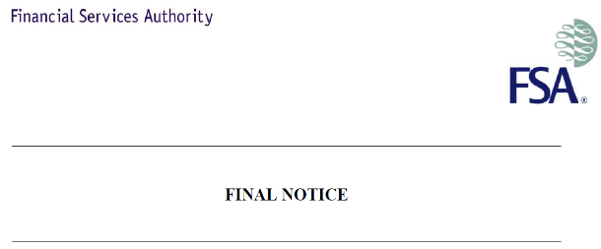




Operational Risk
.. is the risk of loss resulting from inadequate or failed internal processes, people, and systems or from external events. (Basel II, Solvency II)
Processing errors
Internal Fraud
Products & Business Practices
Employment practice
Systems failure
External Fraud
Damage to physical assets

Slide 5
Basle Operational Risk Categories – Level 1 (since 2000)
Internal Fraud - misappropriation of assets, tax evasion, intentional mismarking of positions, bribery
External Fraud - theft of information, hacking damage, third-party theft and forgery
Employment Practices and Workplace Safety - discrimination, workers compensation, employee health and safety
Clients, Products, and Business Practice - market manipulation, antitrust, improper trade, product defects, fiduciary breaches, account churning
Damage to Physical Assets - natural disasters, terrorism, vandalism
Business Disruption and Systems Failures - utility disruptions, software failures, hardware failures
Execution, Delivery, and Process Management - data entry errors, accounting errors, failed mandatory reporting, negligent loss of client assets

Slide 6
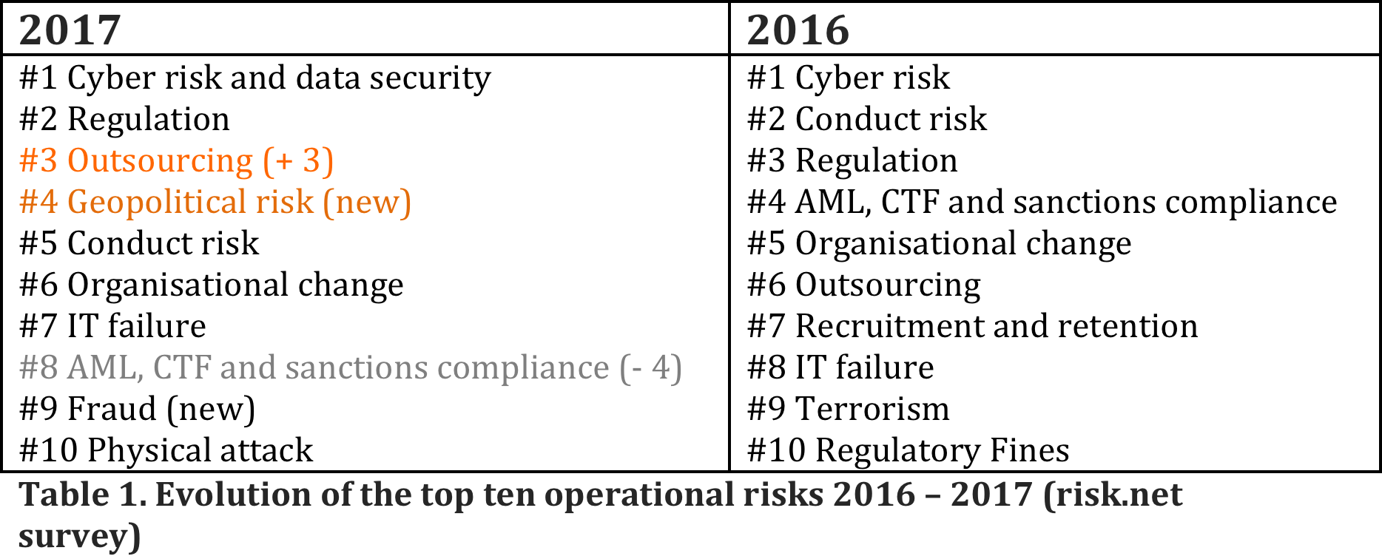
Top Operational Risks 2016 - 2017
Source: Top risks: risk.net survey 2016 & 2017;
Table: A. Chapelle in Risk books “Reflections on Operational Risk Management”, 2017.

Slide 7
Top 10 risks in 2018
Source: Risk.net, Feb 22, 2018

Slide 8
Section 2
Operational Risk:
Features and Challenges

Slide 9
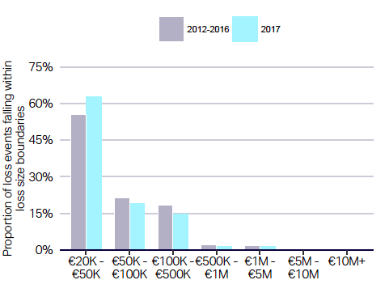
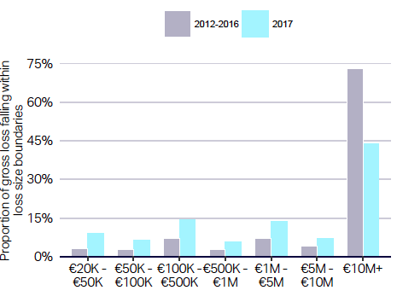
Asymmetry in Operational Losses
Frequency of losses per size
Largest losses: 0.4% of the occurrences, 73% of the severity
Severity of losses per size
Smallest losses: 55% of the occurrences, 3% of the severity
Source: ORX loss report. 2018

Slide 10
OR Extreme losses - Illustration

Slide 11
ORM Strengths and Weaknesses: CRO survey 2017
Source: The Future of Operational Risk, ORX / McKinsey, May 2017

Slide 12
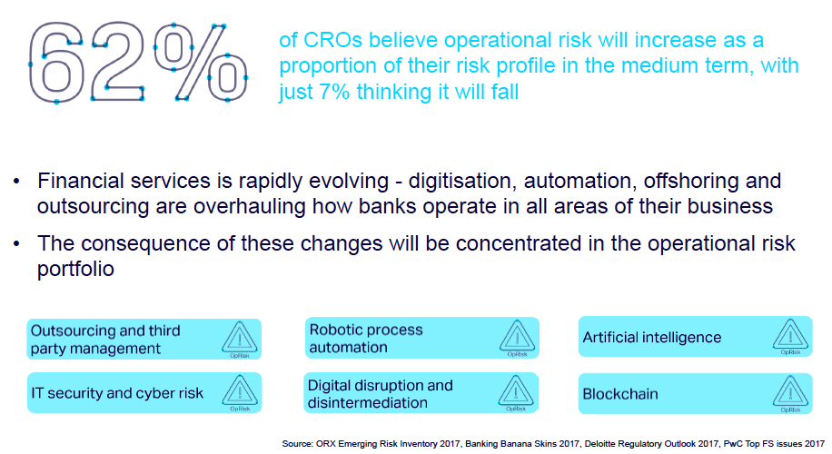
Operational Risk is increasing (and new technologies are scary)
Source: CRO Survey 2018 (ORX – McKinsey)

Slide 13
Section 3
Model types for operational risk

Slide 14
Model types in AMA context (current)
Context: Advanced Measurement Approach
Yearly VaR @ 99.9% for regulatory capital
Stochastic models, based on loss data (past 10 years)
Loss Distribution Approaches (LDA)
Mixing of Internal and External Data
Bootstrapping, EVT, asymptotic models
Scenario-based models
Prospective plausible extreme events, “scenarios”
Severity assumptions in extreme conditions
Stress-testing on assumptions of internal and external factors (economic conditions)
Assumptions on scenario correlations
Hybrid models
Combining loss data and scenarios distributions

Slide 15
OR model: a mix of distributions and inputs
Best modeled with internal loss data
Best modeled with
external loss data and scenario analysis
Best modeled with scenario analysis and stress testing
Source: Chapelle, Crama, Hübner and Peters, Journal of Banking and Finance, 2008
15

Slide 16
AMA: Use of four components into modelling (case study)
BODY
TAIL
Internal Loss Data
Cut-off based on frequency threshold
External Loss Data (ORX)
Scenarios
BEICF
RCSA (frequency assessment of control failures)

Slide 17
Model-Based Scenarios:
Structured Scenario Assessment
&
Factor modelling

Slide 18
Structured Scenario Assessment
Decompose scenario likelihood into its drivers & estimate range of value
E.g. L / M / H data range for each drivers -> type of Fault Tree Analysis (FTA)
Decompose scenario impact into its drivers & estimate range of value
! Don’t forget exposure for the impact assessment -> see illustration on next page
Values of different drivers can be / are often interdependent
E.g type of data leaked with number of access / leaking mechanism / types of impact -> conditional probabilities / Bayesian networks
Run MC simulations of various combinations of probabilities & impacts of each factor (driver) to obtain scenario distribution
Simple case: independent factors
General case: conditional probabilities

Slide 19
FTA: the Importance of Exposure - Illustration
Scenario: data leakage from internal staff
Four conditions:
  Rogue staff
  Access to information
  Capacity to exit information
  Buyer
Probability assessment:
  Market data, business data + judgment
  Lowest probability band (independence)= P1 × P2 × P3 × P4
Exposure: P = 1 for a firm of 40,000 employees
In reality: probabilities / risk factors are interdependent

Slide 20

Scenario Structuring in Cyber Security
Prevention
Filter
Filter 2
Filter 3
Resilience and recovery
Honey Pot
Detect
Range of L – M – H probability of each control failing
Run simulations of different possible combination: LLL to HHH probability of failures
Destroy
Core Data
Back-up
Time to detection (L-M-H)
L-M-H range of data corrupted or stolen
Volume of data lost

Slide 21
Modeling Reputation Impact
Decomposition into reputation components:
  Reputation to whom (stakeholders)
  About what (services / price / ethics..)
  For which possible impact on future business ?
    Impacts elements to model
L
H
£ + reg. scrutiny
Factors:
Nature of events
Communication
Product / brand…
£ + loss of customer + loss of new business
Y
£ remediation + productivity loss
Customer detriment & fines
Loss of talents
Bonus reduction
Capacity to recruit
N

Slide 22
Section 4: Recent Developments
Artificial Intelligence
for Risk Assessment

Slide 23
Summary
SMA reform shifted some of the modeling efforts to other areas
  Model Risk and Model Validation
  Assessment and Modeling of specific risk types (Cyber)
  Risk factors modeling to inform risk management
Tier 1 banks and some risk software providers use ML / AI techniques to:
  Categorize oprisk incidents or customer complaints using NLP
  Identify breaches and fraud, through detection of abnormal patterns (credit card, rogue trading, AML…)
  Identify dependencies between risks based on pattern recognition
  Validate KRIs and define factors of risks (subject to data availability)
  Recommend controls from KRIs, and past remediation of similar incidents
  Predict incidents / elevated risks, from KRIs or risk factors
  Assess audit needs, for a better risk-based allocation

Slide 24
1. Natural Language Processing (NLP):
Project at Credit Suisse
NLP applied to:
  Loss event types
  Root causes
  Third party related incidents
  Reputational risk related incidents
USAGE
  Categorisation of event types
  Root cause mapping
  Third party tagging
  Reputational risk tagging
Credit to: Dimitris Bratzilas, Guest Lecture UCL, December 2018

Slide 25
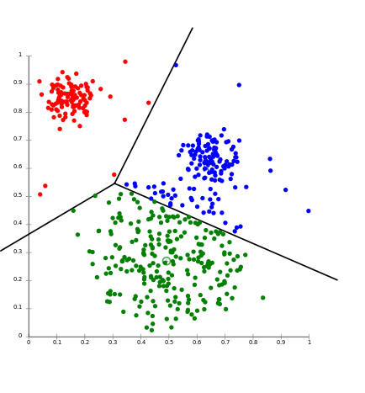
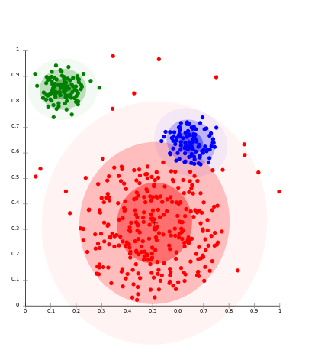
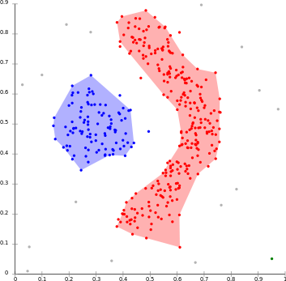
2. Unsupervised Machine Learning:
Pattern Identification for Detective Controls
K-Means
EM Partitioning
Density Approach
Credit: Dr. Bertrand Hassani, InstaDeep, UCL Guest Lecture, October 2018

Slide 26
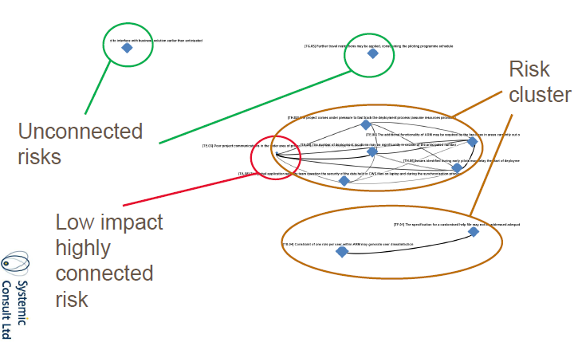
3. Risk Dependencies - Connectivity Graph

Slide 27
Illustration: Network view of the top risks - 2017
#4 Geopolitical risk
#6 Organisational change
#10 Physical attack
#3 Outsourcing
#9 Fraud
#7 IT failure
#5 Conduct risk
#1 Cyber risk and data security
#8 AML, CTF and sanctions compliance
#2 Regulation
Source: A. Chapelle “Reflections on Operational Risk Management”, 2017, Risk books.

Slide 28



4. Key Risks Indicators (KRI) validation
KRI
Risks
Events
Impacts
Stretch
Overload of human and machines
Overtime and delays, stress at work and engagement (HR)
Overcapacity of systems, overload, disruption and break down (Systems)
Exposure
Changes from external factors and changes to risk exposure (External Events)
Changes in risk drivers, stakeholders, regulatory and competitive environment
Failure
Failed performance and failed controls
KPI becomes a KRI when different than green
Ineffective controls elevate risks (failed KCIs are KRIs)
Metrics of risk drivers, both of impacts and likelihood,
If different than the categories below: specifically linked to the features of a given organisation (Process)
Causal
Real need of proper validation of risk factors (beyond current intuition) to enhance prevention
Requires volumes of reliable data first

Slide 29
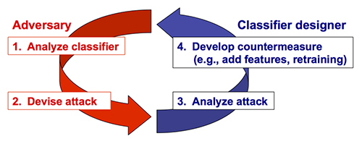
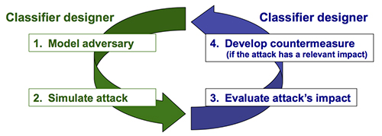
5 & 6. Incident prediction and controls: Adversarial Strategies (InstaDeep)
Reactive
Proactive
Credit: Dr. Bertrand Hassani, InstaDeep, UCL Guest Lecture, October 2018

Slide 30
Challenges
Reality
ML and AI require:
High volume of data
High quality data
Understanding of business constraints
And may suffer from the “black-box” argument, lack of transparency

Slide 31
To conclude:
Food for thought and final questions

Slide 32
Challenges and Questions
How to model a risk that is
  Heterogeneous?
    Unit of Measures in an answer,
    But how to capture dependencies?
  Strongly fat tailed?
    Is there a point to model small events?
    Or is tail modeling only, enough?
  Evolving in nature and subject to a learning process?
    Can the past reflect the future?
    Can the learning process and risk mitigation make future events, by construction, different than past ones?
    Do firms or industries learn from past mistakes? Are repeated events the sign of a poor learning process?
  Not quite understood in its loss generation mechanisms?
    Can AI finally help?
    How to find the volume and quality of data necessary for it?

Slide 33
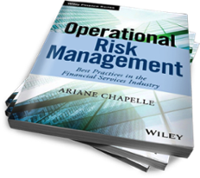
To know more
Operational Risk Management: Best Practices for the Financial services industry
Chapelle, John Wiley & Sons, Dec 2018
Introduction
PART ONE Risk Identification
CHAPTER 1 Tools for Risk Identification
CHAPTER 2 Scenario Identification Process
CHAPTER 3 Risk Register and Taxonomy
CHAPTER 4 Risk Connectivity
PART TWO Risk Assessment
CHAPTER 5 Risk Appetite
CHAPTER 6 Risk and Control Self Assessment
CHAPTER 7 Scenario Assessment Process
CHAPTER 8 Regulatory Capital and Modeling
PART THREE Risk Mitigation
CHAPTER 9 Operational Risk Governance
CHAPTER 10 Risk Mitigation
CHAPTER 11 Root Cause Analysis and Action Plans
CHAPTER 12 Conduct and Culture
PART FOUR Risk Monitoring
CHAPTER 13 Incident Data Collection
CHAPTER 14 Key Indicators
CHAPTER 15 Risk Reporting
CHAPTER 16 The Value of Risk Management
PART FIVE Rising Operational Risks
CHAPTER 17 Risk Management for Projects
CHAPTER 18 Information Security Risks
CHAPTER 19 Operational Risks in crypto currencies
CHAPTER 20 Resilience and Reputation
Conclusion

